Slide 1

JADAVPUR UNIVERSITY
IC DESIGN & FABRICATION CENTRE SUMMER TRAINING REPORT
On VLSI DESIGN AND MICROELECTRONICS TECHNOLOGY
SUBMITTED BY - KOUSHANI
DATTA (GROUP 2)
COLLEGE NAME-HERITAGE INSTITUTE OF TECHNOLOGY
Ph -9330866597
Email Id-Koushani.datta.ece24@heritageit.edu.in

Slide 2
INDEX
SL NO. | CONTENTS | PAGE NO.
1. | EDA ANALOG | 3-23
2. | VERILOG | 24-51
3. | FPGA | 52-72
4. | EDA DIGITAL | 73-99
5. | MICROELECTRONICS | 100-117

Slide 3
ELECTRONICS DEVICE AUTOMATION ANALOG
Electronic Design Automation, or EDA, is a market segment consisting of software, hardware, and services with the collective goal of assisting in the definition, planning, design, implementation, verification, and subsequent manufacturing of semiconductor devices, or chips. Regarding the manufacturing of these devices, the primary providers of this service are semiconductor foundries, or Labs. These highly complex and costly facilities are either owned and operated by large, vertically integrated semiconductor companies or operated as independent, “pure-play” manufacturing service providers. This latter category has become the dominate business model.
Page 3

Slide 4
Declaration
I have finished this lab report on EDA Analog Lab after studying. I would like to express my sincere gratitude to Ms. Jhilam Jana ma’am of Jadavpur University for her assistance. I would want to express my gratitude to everyone who provided assistance with this report , whether directly or indirectly. It would be impossible to create this report without their assistance.

Slide 5
Certiﬁcate
This is to certify that this lab report entitled EDA Analog Lab Report is a record of Bonafide work, carried out by Koushani Datta , under my guidance at IC Design and Fabrication Centre, Jadavpur University. In my opinion, the report in its present form is in partial fulfilment of the requirements for the award of the degree of BACHELOR OF TECHNOLOGY and as per regulations of the Jadavpur University
. To the best of my knowledge, the results embodied in this report, are original in nature and worthy of incorporation in the present version of the report.
Guide/Supervisor Ms. Jhilam Jana

Slide 6
Contents
SI No. | Experiment Name | Page No.
1 | Design and DC Analysis of CMOS Inverter | 7-8
2 | Design and DC Analysis of Resistive Load CMOS Inverter | 9-10
3 | Design and DC Analysis of Capacitive Load CMOS Inverter | 10-11
4 | Design and Analysis of following expression: A.B+C | 12-13
5 | Design and Analysis of Current Mirror Circuit | 14-15
6 | Design and Analysis of Diﬀerential Amplifier | 16-17
7 | Design and Analysis of Class-B Push-Pull Amplifier | 18-19
8 | Design and Analysis of Voltage Controlled Oscillator | 20-21

Slide 7
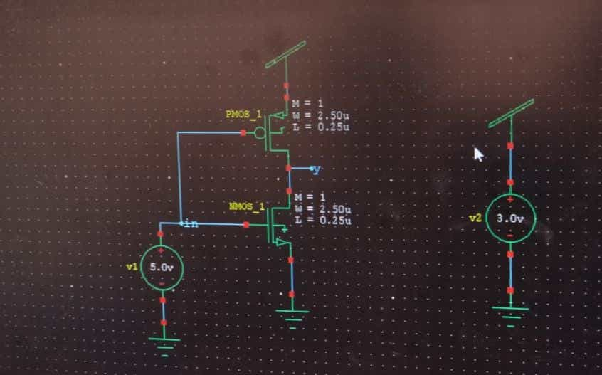
Experiment 1: Design and DC Analysis of CMOS Inverter
Theory: The basic structure of a Complementary Metal oxide semiconductor inverter consists of an n-MOS transistor and p-MOS transistor as a load and the gates of the two transistors are shorted at the input and the drains of the two transistors are also shorted where the outputis obtained. The source n-MOS and p- MOS transistors of the CMOS Inverter are connected to the ground and supply respectively.
Circuit Schematic

Slide 8
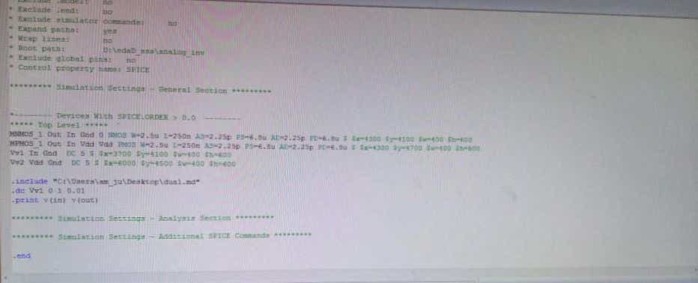
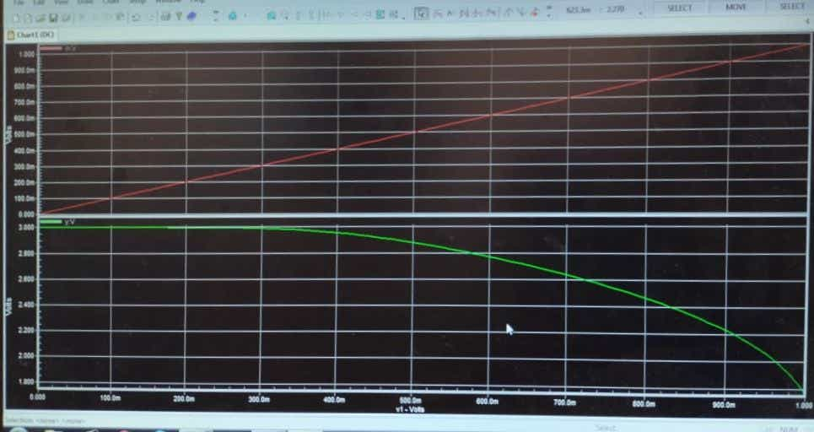
T-Spice Code
Output Waveform

Slide 9
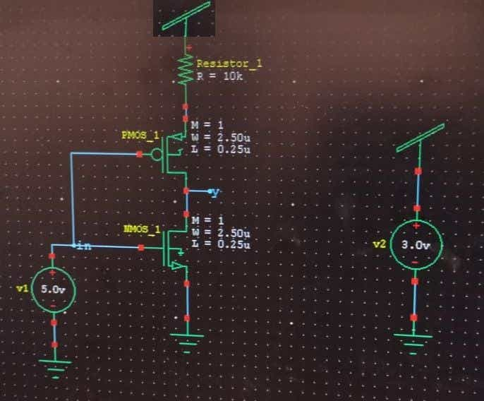
Experiment 2 : Design and DC Analysis of CMOS Resistive Load Inverter
Theory: The average DC power consumption of the resistive-load inverter circuit is found by considering two cases, Vin = VOL (Low) and Vi. = VOH (high). When the input voltage is equal to VOL, the driver transistor is in cut-oﬀ. Consequently, there is no steady-state current ﬂow in the circuit (ID
= IR = 0), and the DC power dissipation is equal to zero. When the input voltage is equal to VOW on the other hand, both the driver MOSFET and the load resistor conduct a nonzero current. Since the output voltage in this case is equal to VOL' the current drawn from the power supply can be found as: The chip area occupied by the resistive-load inverter circuit depends on two parameters, the (W/L) ratio of the driver transistor and the value of the resistor RL. The area of the driver transistor can be approximated by the gate area, (W.L).
Circuit Schematic

Slide 10
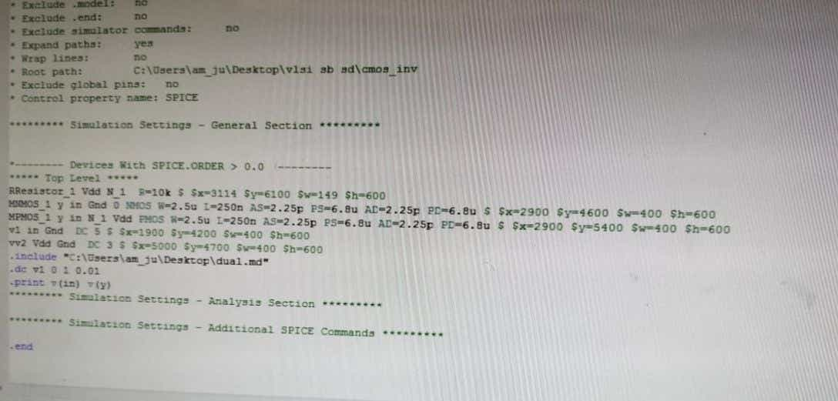
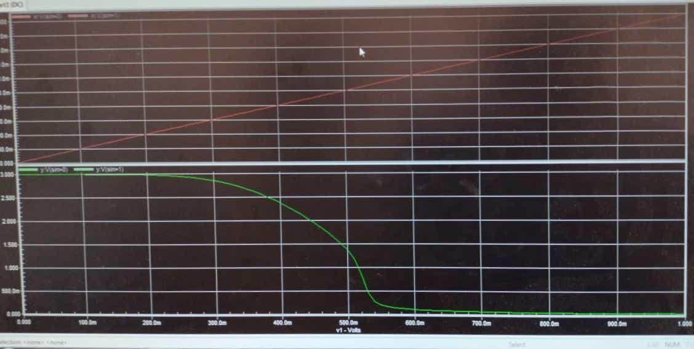
T-Spice Code
Output Waveform

Slide 11
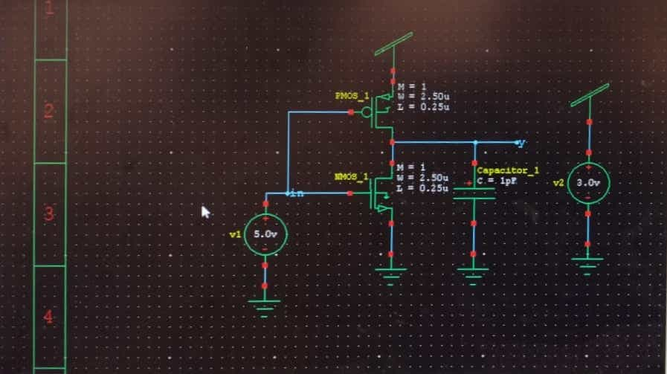
Experiment 3: Design and DC Analysis of Capacitive Load CMOS Inverter
Theory: When the low input voltage is given to the CMOS inverter, then the PMOS transistor is switched ON whereas the NMOS transistor will switch OFF by allowing the flow of electrons throughout the gate terminal & generating high logic output voltage.
.
Circuit Schematic
11 | P a g e

Slide 12
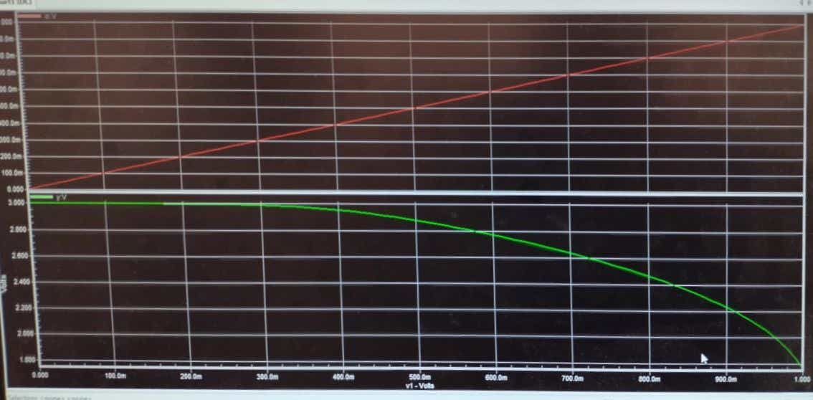
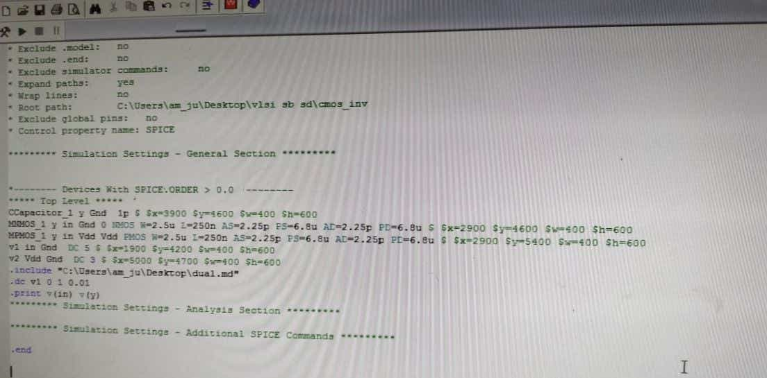
Output Waveform
TSPICE CODE:

Slide 13

Experiment 4: Design and Analysis of following expression : A.B+C
Theory: CMOS is an inverted logic circuit. So, we realise the Boolean Expression (A.B+C)’ in Pull Down Network, to drive an output equivalent of (A.B+C).
Circuit Schematic:

Slide 14
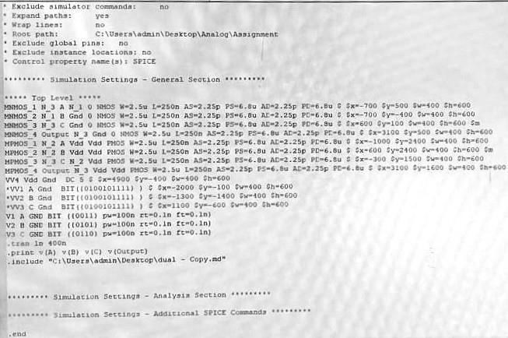
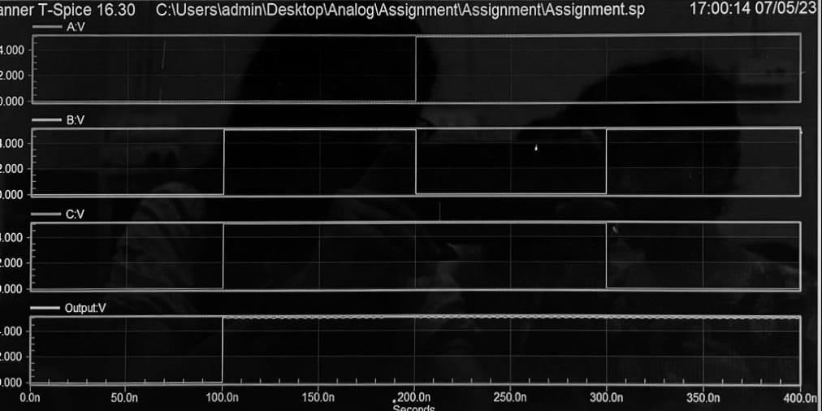
T- Spice Code
Output Waveform

Slide 15
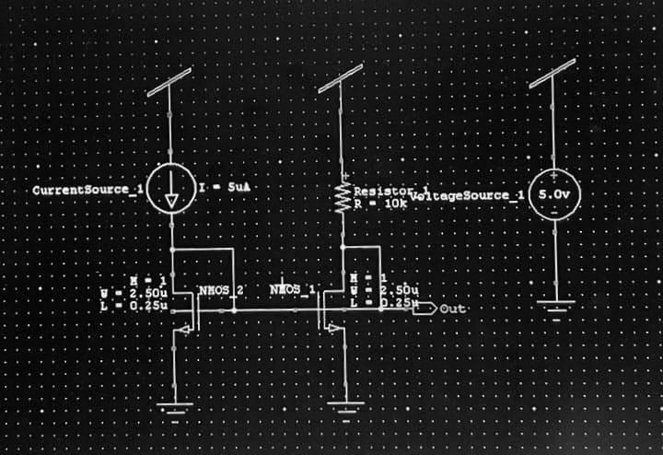
Experiment 5: Design and Analysis of Current Mirror Circuit
Theory: The current mirror is an analog circuit that senses the reference current and generates the copy or number of copies of the reference current, with the same characteristics. The replicated current is as stable as the reference current source. The replicated current could be the same as the reference current, or it could be either multiple or fraction of the reference current. Current Mirrors are particularly useful in the integrated circuits, for biasing the amplifiers. The advantage of biasing the amplifiers with the current source is that it provides a high voltage gain and good biasing stability.
Circuit Schematic

Slide 16
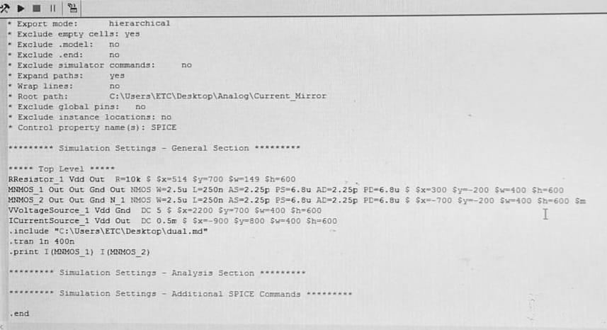
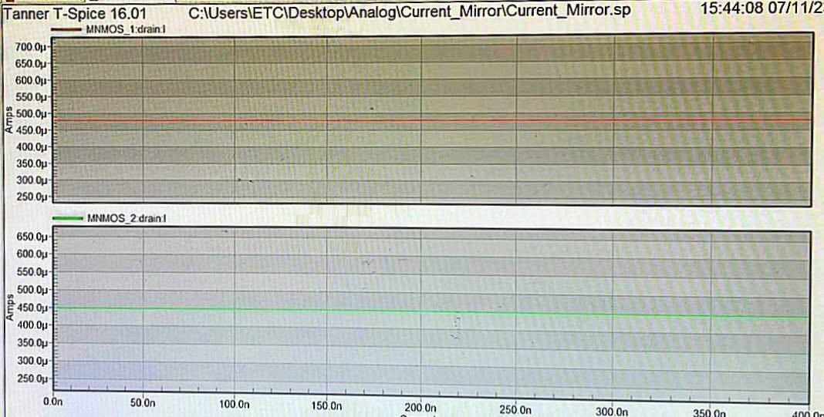
T-Spice Code
Output Waveform

Slide 17
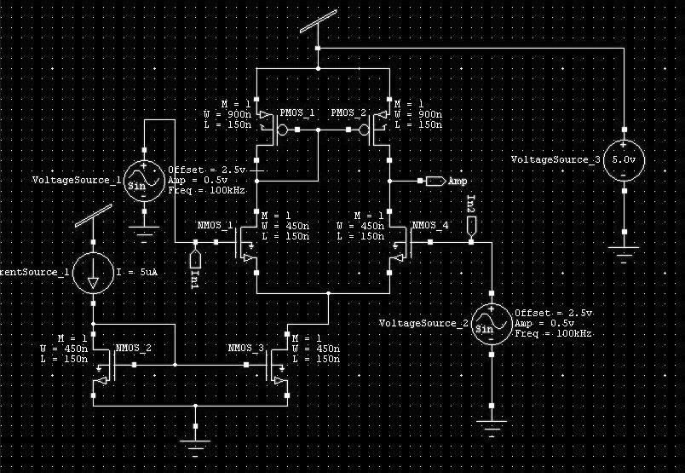
Experiment 6: Design and Analysis of Diﬀerential Ampliﬁer
Theory: A differential amplifier is a circuit whose output voltage is directly proportional to the difference between voltages applied at it's to inputs. Ideally, this amplification of voltage difference is useful in eliminating noise signal which is common to both the inputs i.e. a Common Mode Rejection Ratio of infinity.
Circuit Schematic
T- Spice Code

Slide 18
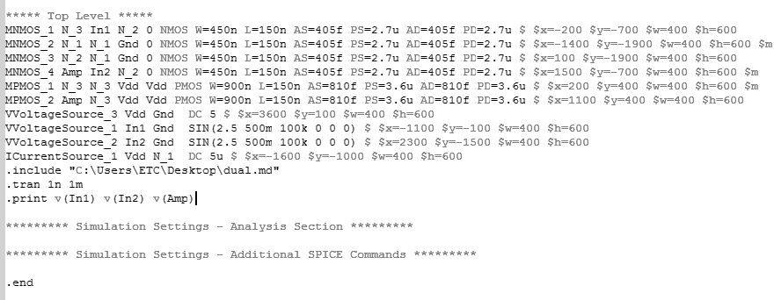
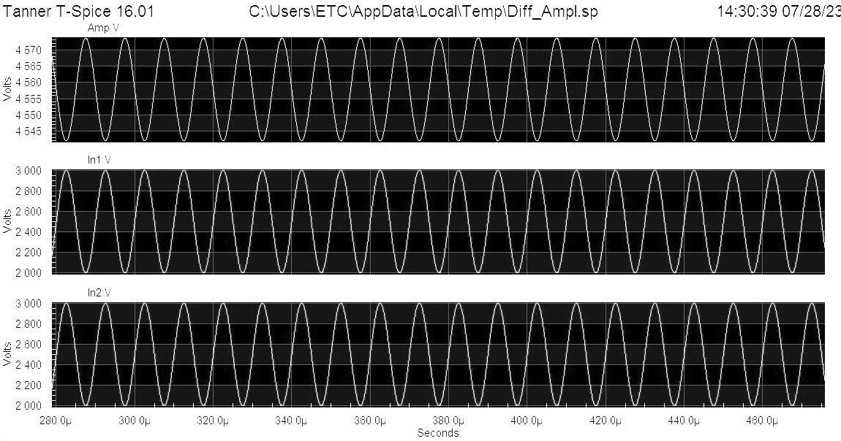
Output Waveform

Slide 19
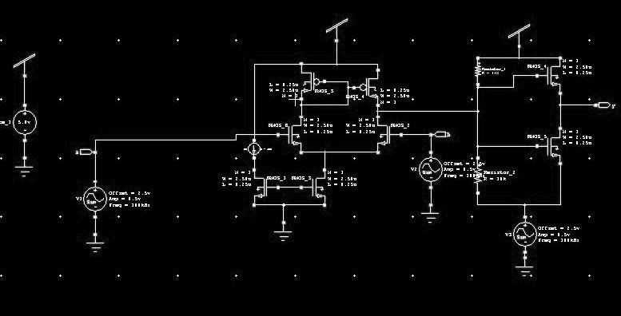
Experiment 7: Design and Analysis of Class-B Push-Pull
Ampliﬁer
Theory: Push-Pull Amplifier is a power amplifier which is used to supply high power to the load. It consists of two transistors in which one is NPN and another is PNP. One transistor pushes the output on positive half cycle and other pulls on negative half cycle, this is why it is known as Push-Pull Amplifier.
Circuit Schematic
T- Spice Code

Slide 20
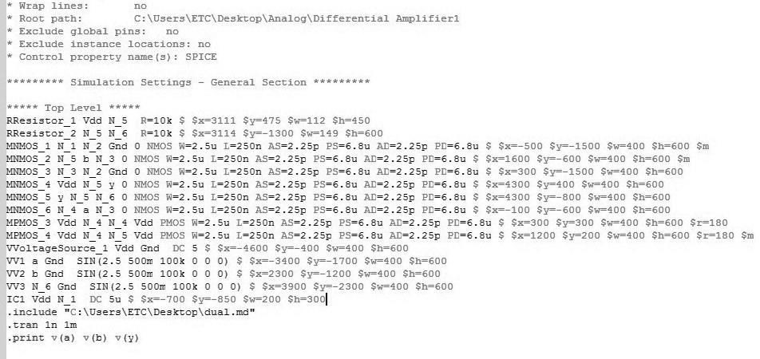
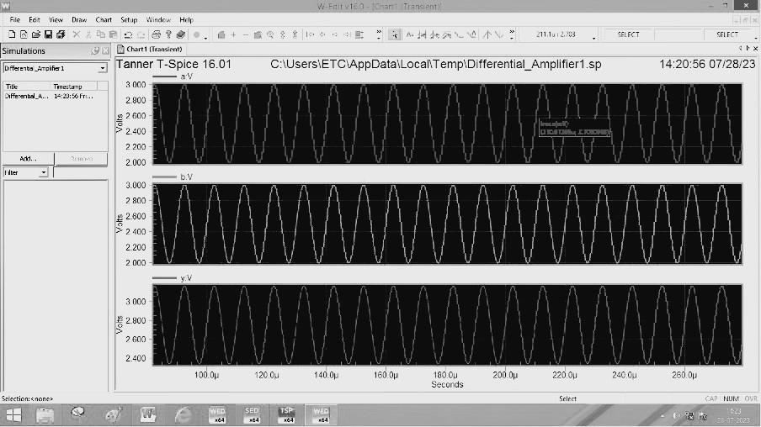
Output Waveform

Slide 21
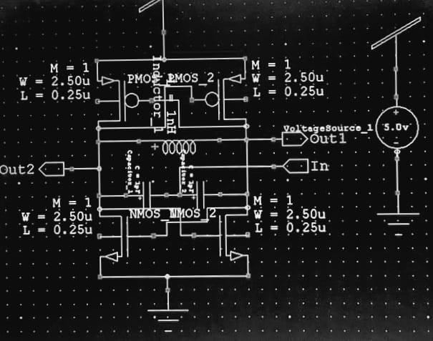
Experiment 8: Design and Analysis of Voltage Controlled Oscillator
Theory: For a Voltage controlled oscillator generating a sawtooth waveform, the main component is the capacitor who’s charging and discharging decides the formation of the output waveform. The input is given in form a voltage that can be controlled. This voltage is converted to a current signal and is applied to the capacitor. As the current passes through the capacitor, it starts charging and a voltage starts building across it. As the capacitor charges and the voltage across it increase gradually, the voltage is compared with a reference voltage using a comparator.
When the capacitor voltage exceeds the reference voltage, the comparator generates a high logic output that triggers the transistor, and the capacitor is connected to the ground and starts discharging. Thus the output waveform generated is the representation of the charging and discharging of the capacitor and the frequency is controlled by the input dc voltage.
Circuit Schematic
T- Spice Code
21 | P a g e

Slide 22
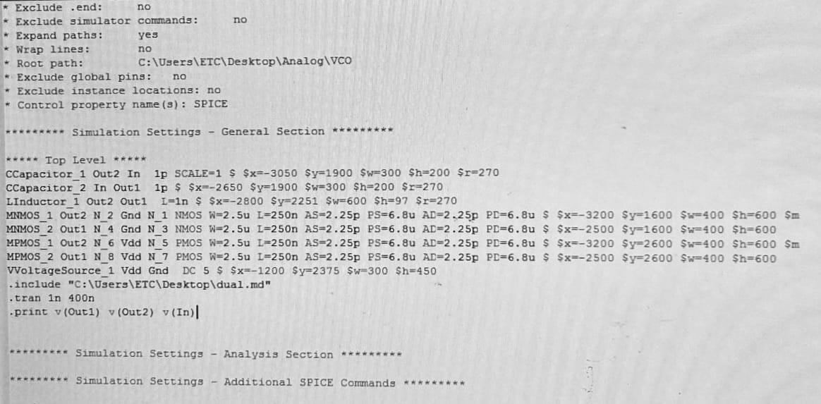
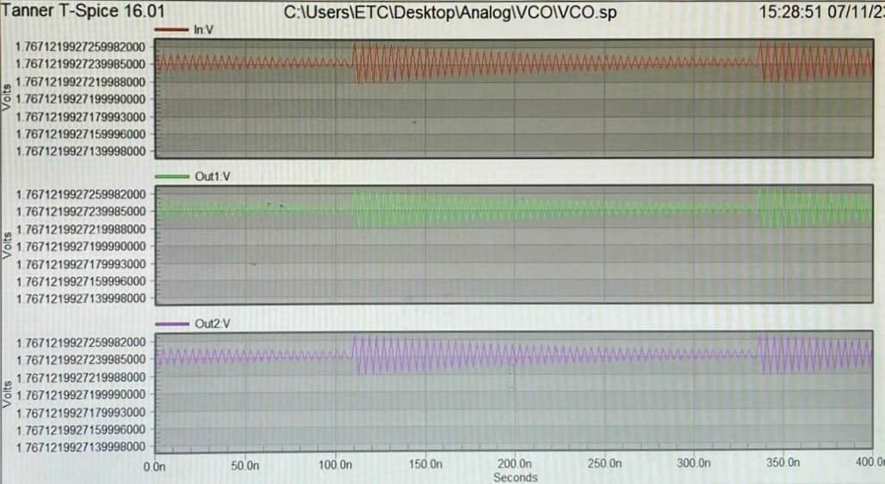
Output Waveform
22 | P a g e

Slide 23
Conclusion
In conclusion, by making this lab report I have been introduced to Electronic Design Automation (Analog Technology) and I can now clearly design or implement diﬀerent semiconductor devices. I also learned about diﬀerent kind of EDA tools. And also why Electronic Design Automation is important for circuit implementation.
23 | P a g e

Slide 24
. Verilog
Verilog is a Hardware Description Language; a textual format for describing electronic circuits and systems. Applied to electronic design, Verilog is intended to be used for verification through simulation, for timing analysis, for test analysis (testability analysis and fault grading) and for logic synthesis.
24 | P a g e

Slide 25
Declaration
I have finished this lab report on Verilog Lab after studying. I would like to express my sincere gratitude to Mr. Rajib Samadder sir of Jadavpur University for his assistance. I would want to express my gratitude to everyone who provided assistance with this report, whether directly or indirectly. It would be impossible to create this report without their assistance.
25 | P a g e

Slide 26
Certificate
This is to certify that this lab report entitled Verilog is a record of Bonafide work, carriedout by , Koushani Datta under my guidance at IC Design and Fabrication Centre, JadavpurUniversity. In my opinion, the report in its present form is in partial fulfilment of the requirements for the award of the degree of BACHELOR OF TECHNOLOGY and as per regulations of the to the best of my knowledge, the results embodied in this report, are original in nature and worthy of incorporation in the present version of the report.
Guide/Supervisor
Mr. Rajib Samadder
26 | P a g e

Slide 27
Contents
SI No. | Experiment Name | Page
1 | Half Adder by Dataflow Method | 28
2 | Half Adder by Behavioural Method | 29-30
3 | 2:4 decoder by Dataflow Method | 31-32
4 | 2:4 decoder by Behavioural Method | 33-34
5 | 2:1 Multiplexer by Dataflow Method | 35-36
6 | 2:1 Multiplexer by Behavioural Method | 37-38
7 | 4 bit up Counter | 39-40
8 | Left Shift Register | 41
9 | Full Adder using Half Adder | 42-43
10 | 3:8 Decoder using 2:4 decoder | 44-45
11 | 4:1 Mux using 2:1 Mux | 46-47
12 | Half Adder using Test Bench | 48-49
13 | 2:4 Decoder using Test Bench | 50-51
27 | P a g e

Slide 28
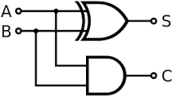
Half Adder using Dataflow Method
Theory :
half adder is a digital logic circuit that performs binary addition of two single-bit binary numbers.It has two inputs, A and B, and two outputs, SUM and CARRY. The SUM output is the least significant bit (LSB) of the result, while the CARRY output is the most significant bit (MSB) of the result, indicating whether there was a carry-over from the addition of the two inputs. The half adder can be implemented using basic gates such as XOR and AND gates.
Circuit Diagram :
Verilog Code :
module ha_df(input a,b,output s,c);assign s=a^b;
assign c=a&b; endmodule
Output :
28 | P a g e

Slide 29
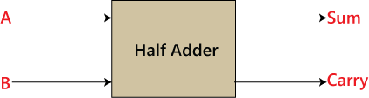
Half Adder Behavioural
Theory :
half adder is a digital logic circuit that performs binary addition of two single-bit binary numbers.It has two inputs, A and B, and two outputs, SUM and CARRY. The SUM output is the least significant bit (LSB) of the result, while the CARRY output is the most significant bit (MSB) of the result, indicating whether there was a carry-over from the addition of the two inputs. The half adder can be implemented using basic gates such as XOR and AND gates.
Circuit Diagram :
Verilog Code :
module ha_behv (input A,B,output reg S,C); always @(A,B)
begin
if(A!=B) S=1;
else S=0;
end
always @(A,B) begin
if(A==1 && B==1) C=1;
else C=0; end
endmodule
29 | P a g e

Slide 30
Output :
30 | P a g e

Slide 31
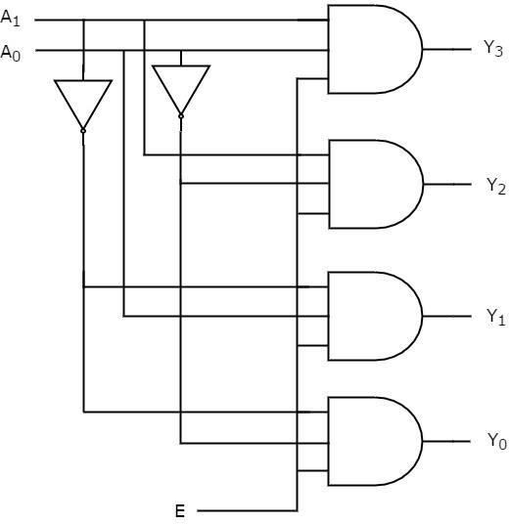
2 to 4 Decoder using Dataflow Method
Theory :
Decoder is a combinational circuit that has ‘n’ input lines and maximum of 2^{n} output lines. Oneof these outputs will be active High based on the combination of inputs present, when the decoder is enabled. That means decoder detects a particular code. The outputs of the decoder are nothing but the min terms of ‘n’ input variables lines, when it is enabled.
Circuit Diagram :
31 | P a g e

Slide 32
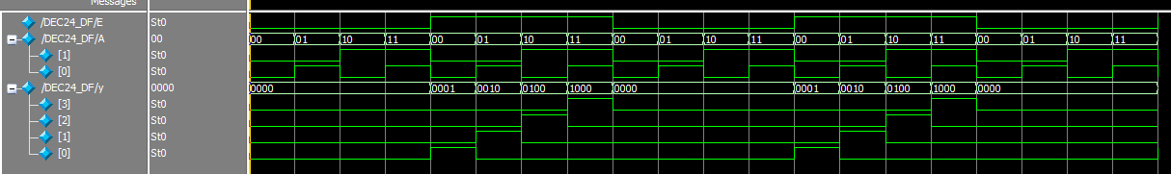
Verilog Code :
module DEC24_DF(input E,[1:0]A,output[3:0]y); assign y[3]=E & A[1] & A[0];
assign y[2]=E & A[1] & (~A[0]);
assign y[1]=E & (~A[1]) & A[0];
assign y[0]=E & (~A[1]) & (~A[0]); endmodule
Output :
32 | P a g e

Slide 33
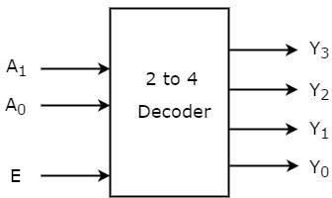
Decoder 2 to 4 Behavioural Method
Theory :
Decoder is a combinational circuit that has ‘n’ input lines and maximum of 2^{n} output lines. Oneof these outputs will be active High based on the combination of inputs present, when the decoder is enabled. That means decoder detects a particular code. The outputs of the decoder are nothing but the min terms of ‘n’ input variables lines, when it is enabled.
Circuit Diagram :
Verilog Code :
module DEC_24_BEHV(input E,[1:0]A,output reg[3:0]Y); always @(E,A)
begin
if(E==1&A==0) Y=4'b0001;
else if(E==1&A==1) Y=4'b0010;
else if(E==1&A==2) Y=4'b0100;
else if(E==1&A==3) Y=4'b1000;
else Y=4'b0000;
end endmodule
33| P a g e

Slide 34
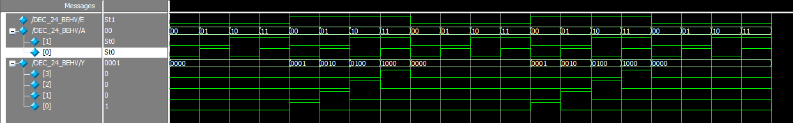
Output :
34 | P a g e

Slide 35
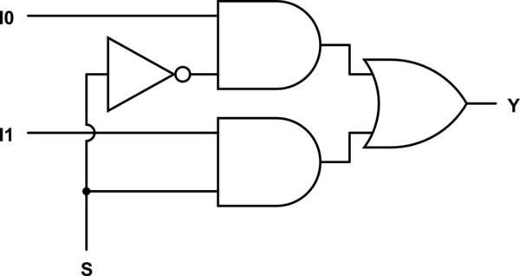
2 to 1 multiplexer using Dataflow Method
Theory :
A multiplexer is a combinational circuit that has 2^{n} input lines and a single output line. Simply,the multiplexer is a multi-input and single-output combinational circuit. The binary information is received from the input lines and directed to the output line. On the basis of thevalues of the selection lines, one of these data inputs will be connected to the output.
Unlike encoder and decoder, there are n selection lines and 2^{n} input lines. So, there is a total of 2^{N} possible combinations of inputs. A multiplexer is also treated as Mux.
Circuit Diagram :
Verilog Code :
module MUX21_DF(input S,[1:0]A,output Y);assign Y=(S&A[1])|(~S&A[0]);
endmodule
35 | P a g e

Slide 36
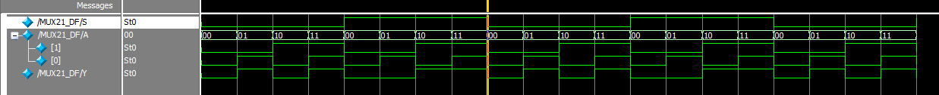
Output :
36 | P a g e

Slide 37
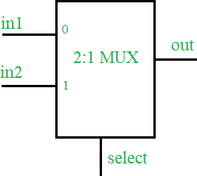
2 to 1 Multiplexer using Behavioral Method
Theory :
A multiplexer is a combinational circuit that has 2^{n} input lines and a single output line. Simply,the multiplexer is a multi-input and single-output combinational circuit. The binary information is received from the input lines and directed to the output line. On the basis of thevalues of the selection lines, one of these data inputs will be connected to the output.
Unlike encoder and decoder, there are n selection lines and 2^{n} input lines. So, there is a total of 2^{N} possible combinations of inputs. A multiplexer is also treated as Mux.
Circuit Diagram :
Verilog Code :
module MUX21_Behv( input S,[1:0]A,output reg Y);always
@(S,A)
begin
if(S==0) Y=A[0];
else Y=A[1]; end endmodule
37 | P a g e

Slide 38
Output :
38 | P a g e

Slide 39
4 bit up Counter
Theory :
A Counter is a device which stores (and sometimes displays) the number of times a particular event or process has occurred, often in relationship to a clock signal. Counters are used in digitalelectronics for counting purpose, they can count specific event happening in the circuit. For example, in UP counter a counter increases count for every rising edge of clock. Not only counting, a counter can follow the certain sequence based on our design like any random sequence 0,1,3,2… .They can also be designed with the help of flip flops. They are used as frequency dividers where the frequency of given pulse waveform is divided. Counters are sequential circuit that count the number of pulses can be either in binary code or BCD form. The main properties of a counter are timing , sequencing , and counting. Counter works in two modes
Up counter
Down counter
Circuit Diagram :
clk
Y(3:0)
Verilog Code :
module counter( input clk, output reg[3:0]Y=4'b0000); always @(posedge clk)
begin
Y=Y+1'b1;
end endmodule
39 | P a g e

Slide 40
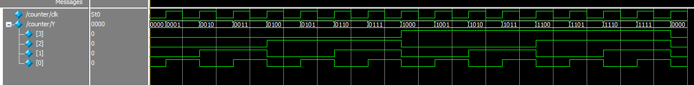
Output :
40 | P a g e

Slide 41
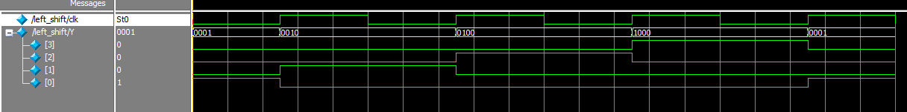
4 bit left shift register
Theory :
A shift register, wherein input data is entered from the right side, whereas digits already present on the register leave out/ remove from the left side, are called shift left registers. In other words, registers which shift input data towards left, are called shift left registers.
Circuit Diagram :
clk
Y(3:0)
Verilog Code :
module left_shift( input clk, output reg[3:0]Y=4'b0001); always @(posedge clk)
begin
Y={Y[2:0],Y[3]};
end endmodule
Output :
41 | P a g e

Slide 42
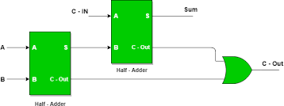
Design of Full adder using Half Adder
Theory :
Full Adder is the adder that adds three inputs and produces two outputs. The first two inputs are A and B and the third input is an input carry as C-IN. The output carry is designated as C- OUT and the normal output is designated as S which is SUM. A full adder logic is designedin such a manner that can take eight inputs together to create a byte-wide adder and cascade the carry bit from one adder to another. we use a full adder because when a carry-in bit is available, another 1-bit adder must be used since a 1-bit half-adder does not take a carry-in bit. A 1-bit full adder adds three operands and generates 2-bit results.
Circuit Diagram :
Verilog Code :
module FA_1(input cin,[1:0]x,output sum,cout); wire s_w;
wire [1:0]c_w;
ha_df u0(.a(cin),.b(x[0]),.s(s_w),.c(c_w[0]));
ha_df u1(.a(s_w),.b(x[1]),.s(sum),.c(c_w[1])); assign cout=c_w[1] | c_w[0];
endmodule
42 | P a g e

Slide 43
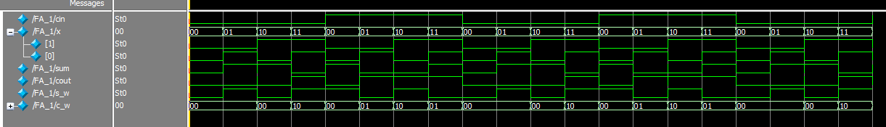
Output :
43 | P a g e

Slide 44
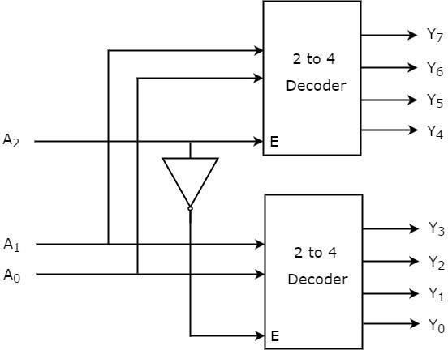
Design 3:8 decoder using 2:4 decoder
Theory :
The 3 to 8 line decoder is also known as Binary to Octal Decoder. In a 3 to 8 line decoder, there is a total of eight outputs, i.e., Y₀, Y₁, Y₂, Y₃, Y₄, Y₅, Y₆, and Y₇ and three outputs, i.e., A₀, A1, and A₂. This circuit has an enable input 'E'. Just like 2 to 4 line decoder, when enable'E' is set to 1, one of these four outputs will be 1.
Circuit Diagram :
Verilog Code :
module DEC38(input [2:0]A1,output [7:0]y1); DEC24_DF u0(.E(A1[2]),.A(A1[1:0]),.y(y1[7:4]));
DEC24_DF u1(.E(~A1[2]),.A(A1[1:0]),.y(y1[3:0]));
endmodule
44 | P a g e

Slide 45
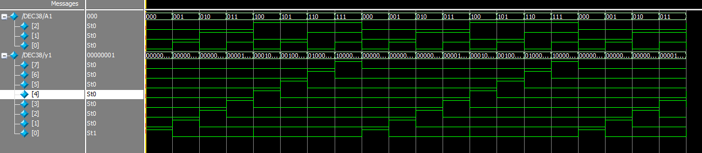
Output :
45 | P a g e

Slide 46
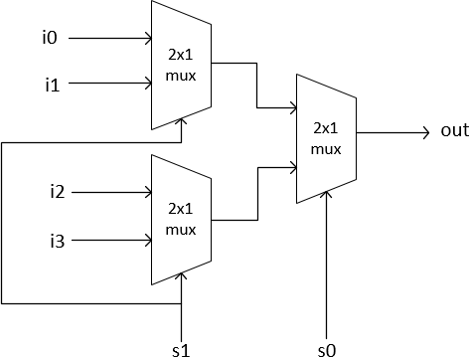
Design 4:1 Multiplexer using 2:1 Multiplexer
Theory :
A 4 to 1 MUX contains “FOUR” input lines and these are D0 D1 D2 and D3, two selected lines S0 and S1 and one output Y-line. Selected lines S0 and S1 select one of the four input lines to connect the outgoing line. The figure below shows a 4 to 1 MUX block diagram where, the multiplexer determines the input by the selected line.
Circuit Diagram :
Verilog Code :
module mux41( input [1:0]S1,[3:0]A1, output Y1);wire [1:0]Y_W;
MUX21_DF u0(.S(S1[0]),.A(A1[3:2]),.Y(Y_W[1]));
MUX21_DF u1(.S(S1[0]),.A(A1[1:0]),.Y(Y_W[0]));
MUX21_DF u2(.S(S1[1]),.A(Y_W),.Y(Y1));
Endmodule
46 | P a g e

Slide 47
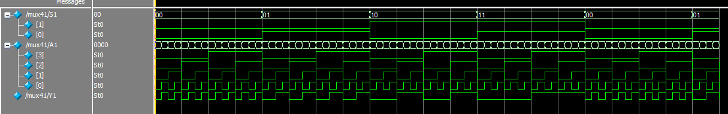
Output :
47 | P a g e

Slide 48
Design Half Adder Using Test Bench
Theory :
half adder is a digital logic circuit that performs binary addition of two single-bit binary numbers.It has two inputs, A and B, and two outputs, SUM and CARRY. The SUM output is the least significant bit (LSB) of the result, while the CARRY output is the most significant bit (MSB) of the result, indicating whether there was a carry-over from the addition of the two inputs. The half adder can be implemented using basic gates such as XOR and AND gates.
Circuit Diagram :
 | H A
A |  | S
B |  | C
Verilog Code :
module HA_TB(); reg A,B;
wire S,C;
ha_df u0(.a(A),.b(B),.s(S),.c(C)); initial
begin
A=0; B=0;
#100; A=0;
B=1;
#100;
48 | P a g e

Slide 49
A=1; B=0;
#100;
A=1; B=1;
#100;
end
endmodule
OUTPUT:
49 | P a g e

Slide 50

2:4 Decoder using Test Bench
Theory :
Decoder is a combinational circuit that has ‘n’ input lines and maximum of 2^{n} output lines. Oneof these outputs will be active High based on the combination of inputs present, when the decoder is enabled. That means decoder detects a particular code. The outputs of the decoder are nothing but the min terms of ‘n’ input variables lines, when it is enabled.
Circuit Diagram :
E A(1:0)
2:4
Y(3:0)
Verilog Code :
module DEC24_TB(); reg E;
reg [1:0]A;
wire [3:0]Y;
DEC24_DF u0(.E(E),.A(A),.y(Y));
initial begin
E=0;
A=2'b00;
# 400;
end always @ begin
50 | P a g e

Slide 51
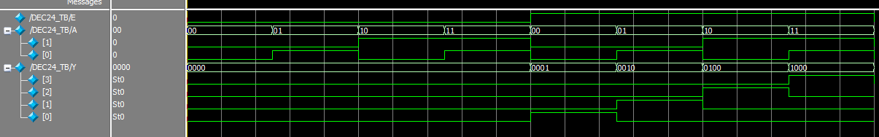
#50; A[0]=~A[0];
end
always @
begin
#100; A[1]=~A[1];
End always@ begin
#200;
E=~E;
end endmodu
OUTPUT:
29 | P a g e

Slide 52
Conclusion
After Completing this Lab I learned about Verilog language and how to operate the ModelsimSoftware. Also learned about various digital electronic circuits like half adder, full adder, decoder, multiplexer etc. I learned about how to implement those circuits in Verilog language. I wrote code on different methods in Verilog and also studied its waveform in simulation.
51 | P a g e

Slide 53
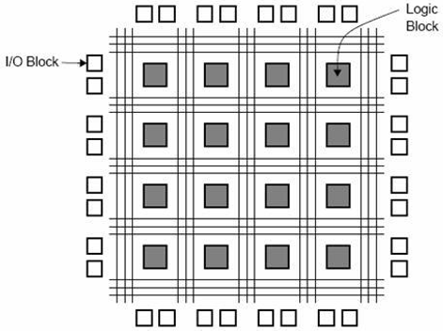
Field programmable gate array
Using artix-7 microcontroller
Package -XILLINX
52 | P a g e

Slide 54
Contents
SI No. | Experiment Name | Page No.
1 | 2 to 4 Decoder | 4-5
2 | 4-bit up counter | 6-7
3 | 4-bit left shift register | 8-9
4 | 4-bit combinational circuit | 10-12
5 | Liquid Crystal Display(LCD) | 13-16
6 | Multiplexed 7- Segment Display | 17-20
53 | P a g e

Slide 55
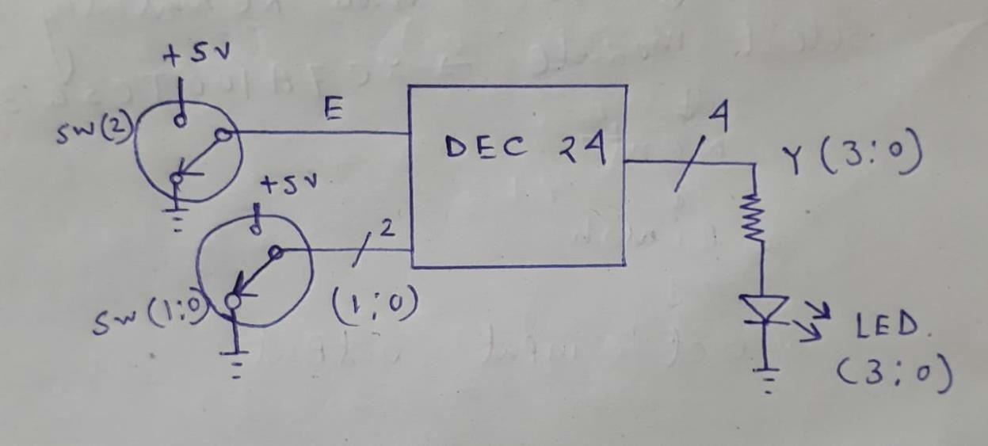
Experiment 1:
2 to 4 Decoder
Block Diagram :
Verilog Code:
module dec24(input e, input [1:0] a, output [3:0] y
);
assign y[3]=e&a[1]&a[0];
assign y[2]=e&a[1]&(~a[0]);
assign y[1]=e&(~a[1])&a[0];
assign y[0]=e&(~a[1])&(~a[0]);
54 | P a g e

Slide 56
endmodule
pin configuration :
A (0) J15
A (1) = L16
E = M13
Y(0) = H17
Y (1)= KI5
Y (2) = J13
Y(3) = N14
55 | P a g e

Slide 57
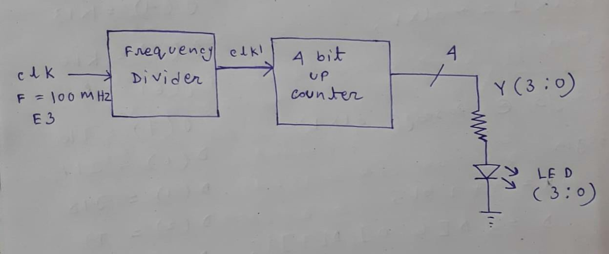
Experiment 2: 4-bit up counter Block Diagram :
Verilog Code:
module up4counter(input clk,
output reg[3:0] y=4'b0000
);
reg clk1=0; integer c=0;
always @ (posedge clk)begin c=c+1;
if (c==25000000)
56 | P a g e

Slide 58
beginc=0; clk1=~clk1;end
end
always @ (posedge clk1)begin y=y+1'b1; end
endmodule
pin configuration :
clk = C3
Y(0) = H17
Y(1) = K15
Y(2) = J13
Y(3) = N14
57 | P a g e

Slide 59
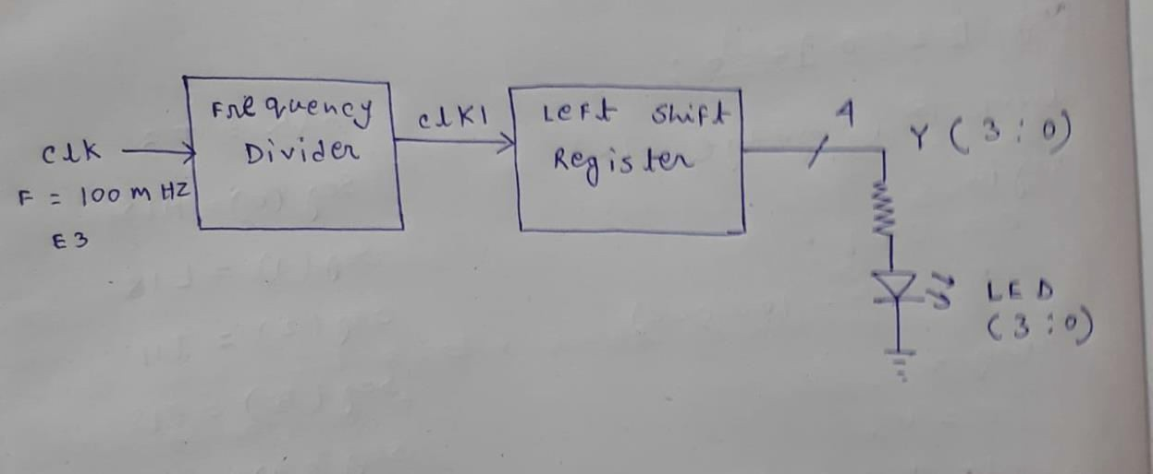
Experiment 3: 4-bit left shift register Block Diagram :
Verilog Code:
module left_shift(input clk,
output reg[3:0] y=4'b0001
);
reg clk1=0; integer c=0;
always @ (posedge clk)begin c=c+1;
58 | P a g e

Slide 60
if(c==25000000)
beginc=0; clk1=~clk1;end end
always @ (posedge clk1)begin y={y[2:0],y[3]};
end endmodule
pin configuration :
clk = C3
Y(0) = H17
Y(1) = K15
Y(2) = J13
Y(3) = N14
60 | P a g e

Slide 61
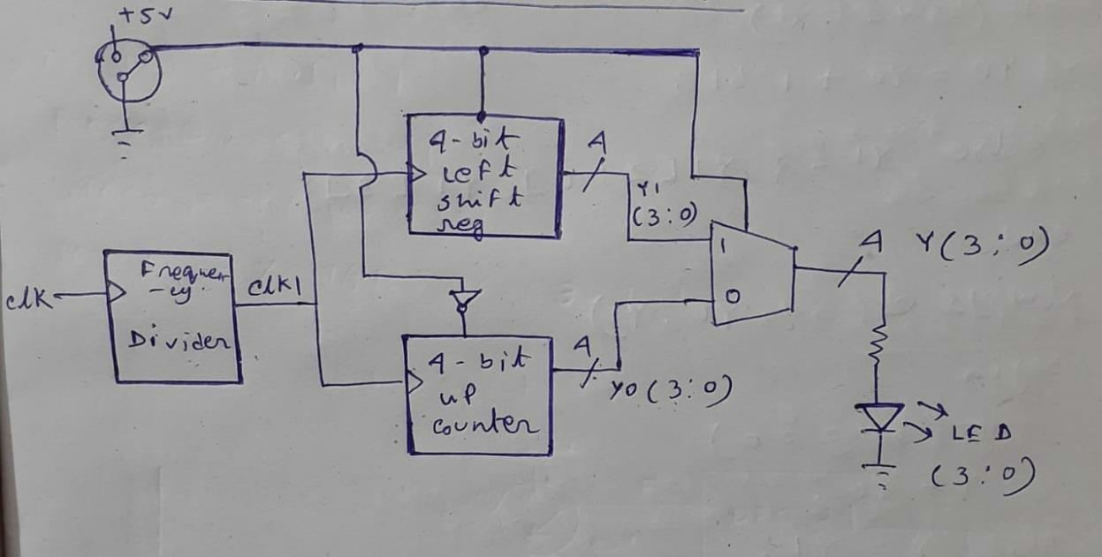
Experiment 4: 4-bit combinational circuit Block Diagram :
Verilog Code:
module bit4_combination(input sw, input clk,
output reg[3:0] y
);
integer c=0;
61 | P a g e

Slide 62
reg clk1=0;
reg [3:0]y0=4'b0000;reg [3:0]y1=4'b0001;
always @(posedge clk)begin c=c+1;
if(c==25000000)
beginc=0; clk1=~clk1;end end
always @(posedge clk1)begin if(sw==0)
y0=y0+1'b1;
else y1={ y1[2:0],y1[3]};end always @(sw,y0,y1)begin
62 | P a g e

Slide 63
if(sw==0)y=y0; else y=y1;end endmodule
pin configuration :
sw=j15 | clk=E3
y(0)=H17 | y(1)=K15
y(2)=J13 | y(3)=N14
63 | P a g e

Slide 64
Experiment 5: Liquid Crystal Display(LCD) Verilog Code: (For print ‘EDA’ on LCD)
module lcd(
input clk, output rw, output reg rs, output reg e, output reg [7:0] db
);
integer c=0;reg clk1=0; integer n=0;
always @ (posedge clk)begin c=c+1;
if(c==750000)
beginc=0;
64 | P a g e

Slide 65
clk1=~clk1;end end
always @ (posedge clk1)begin n=n+1;
if(n>9)n=n;
end
always @ (n)begin case(n) 0:db=8'h30;
1:db=8'h30;
2:db=8'h30;
3:db=8'h38;
4:db=8'h0c; 5:db=8'h06;
6:db=8'h01;
7:db=8'h45;
65 | P a g e

Slide 66
8:db=8'h44;
9:db=8'h41;
default:db=8'h00; endcase
end
always @(n)begin if(n<7)
rs=0;
else rs=1;end
always @(n) begin if(n>9) e=0;
else e=clk1; end
assign rw=0; endmodule
66 | P a g e

Slide 67
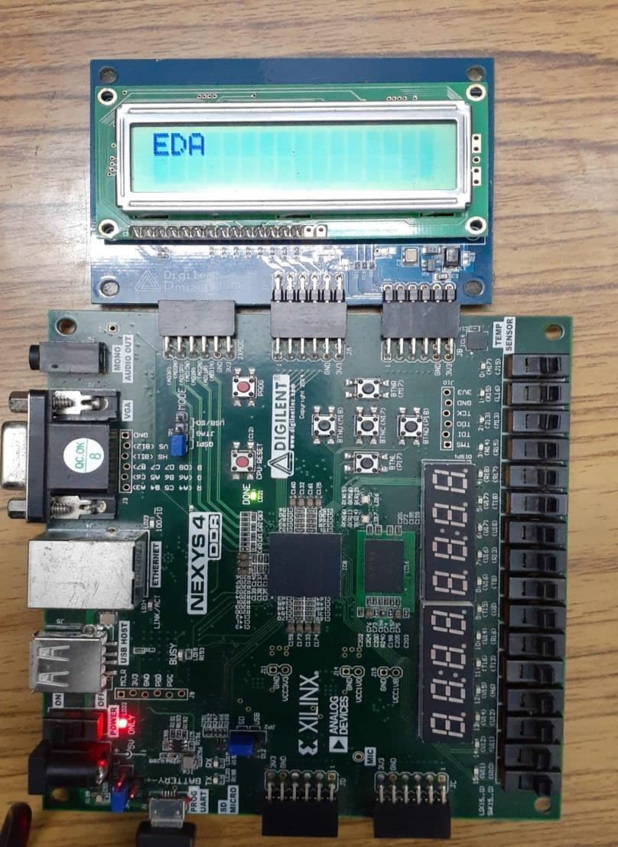
pin configuration :
clk =E3 | db(0) =C17 | db(4) = D17
rs =E16 | db(1) = D18 | db(5) = E17
rw = F13 | db(2) = E18 | db(6)=F18
e=G13 | db(3) = G17 | db(7) = G18
output:
67 | P a g e

Slide 68
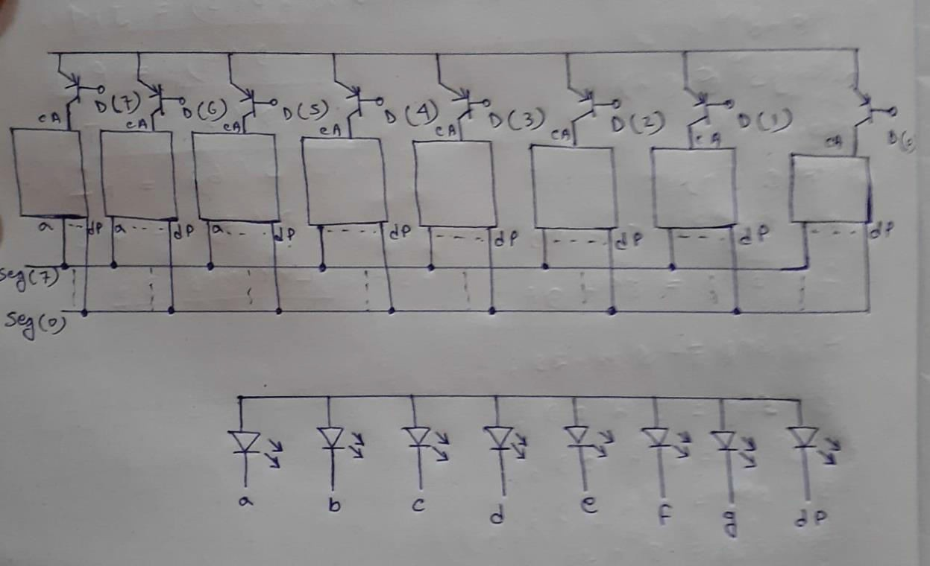
Experiment 6: Multiplexed 7-Segment Display Block Diagram :
Verilog Code: (For print 0 to 7)
module segment7disp(input clk,
output reg [7:0] d=8'hFE,output reg [7:0] seg
);
integer c=0;reg clk1=0;
68 | P a g e

Slide 69
reg [2:0]n=0;
always @ (posedge clk)begin c=c+1;
if(c==100000)
beginc=0;
clk1=~clk1;end end
always @ (posedge clk1)begin n=n+1'b1;
d={d[6:0],d[7]};
end
always @ (n)begin case(n) 0:seg=8'h03; 1:seg=8'h9F;
69 | P a g e

Slide 70
2:seg=8'h25; 3:seg=8'h0D; 4:seg=8'h99; 5:seg=8'h49; 6:seg=8'h41; 7:seg=8'h1F; default:seg=8'hFF; endcase
end endmodule
pin configuration :
clk =E3 | seg (0) = HI5 | seg (1) = L18
seg(2) =T11 | seg(3) =P15 | seg(4) =k13
seg (5) = K16 | seg(6) =R10 | seg(7) =T10
d (0 )= J17 | d(1)=J18 | d (2) =T9
d(3) =J14 | d(4) =P14 | d(5) =T14
d(6) =K2 | d(7) = u13
70 | P a g e

Slide 71
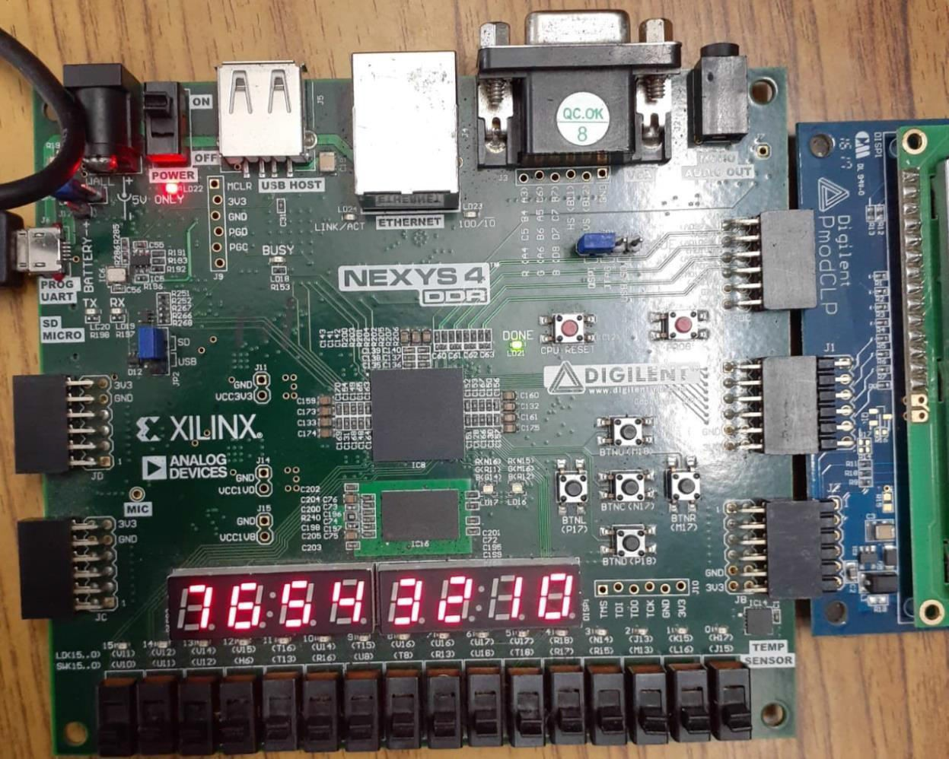
Output:
71 | P a g e

Slide 72
Conclusion
After the FPGA lab,I learned how to use the vivado software which is used for making the said projects . Here verilog language is used which I am familiar with.

Slide 73
Electronics
Device
Automation
(digital)
Electronic design automation (EDA), also referred to as electronic computer-aided design (ECAD), is a category of software tools for designing electronic systems such as integrated circuits and printed circuit boards. The tools work together in a design flow that chip designers use to design and analyze entire semiconductor chips. Since a modern semiconductor chip can have billions of components, EDA tools are essential for their design; this article in particular describes EDA specifically with respect to integrated circuits (ICs).

Slide 74
Declaration
I have finished this lab report on EDA Digital Lab after studying. I would like to express my sincere gratitude to Mr. Prabir Mondal sir of Jadavpur University for hisassistance. I would want to express my gratitude to everyone who provided assistance with this report , whether directly or indirectly. It would beimpossible to create this report without their assistance.

Slide 75
Certificate
This is to certify that this lab report entitled EDA Digital Lab Report is a record of Bonafede work, carried out by , Prabir Mondal under my guidance at IC Design and Fabrication Center, Jadavpur University. In my opinion, the report in its present form is in partial fulfilment of the requirements for the award of the degree of BACHELOR OF TECHNOLOGY and as per regulations of the Jadavpur University . To the best of my knowledge, the results embodied in this report, are original in nature and worthy of incorporation in the present version of the report.
Guide/Supervisor Mr. Prabir Mondal

Slide 76
Contents
SI No. | Experiment Name | Page No.
1 | Design and Implementation of CMOS Inverter | 5-6
2 | Design and Implementation of Resistive Load Inverter | 7-8
3 | Design and Analysis of NAND gate using CMOS | 9-10
4 | Design and Analysis of NOR gate using CMOS | 11-12
5 | Design and Analysis of XOR gate using CMOS | 13-14
6 | Design and Analysis of TG XOR gate using CMOS | 15-16
7 | Design and Analysis of TG OR gate using CMOS | 17-18
8 | Design and Analysis of TG AND gate using CMOS | 19-20
9 | Design and Analysis of 6TG XOR gate using CMOS | 21-22
10 | Design and Analysis of CMOS Sub circuit | 23-24
11 | Design Half Adder using CMOS | 25-26

Slide 77
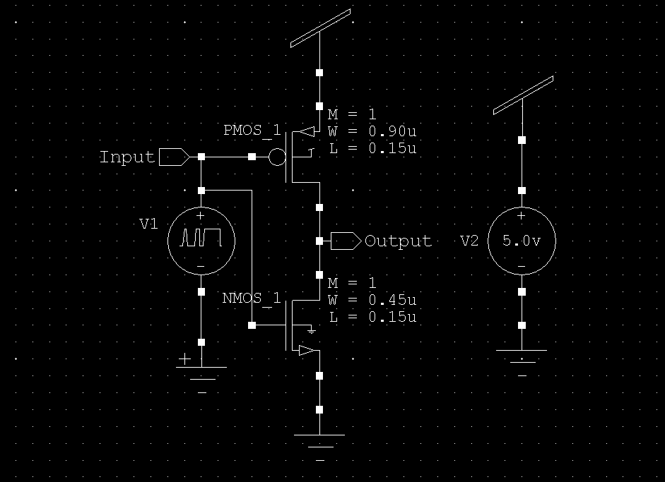
Experiment 1: Design and Analysis of CMOS Inverter
Theory: The basic structure of a Complementary Metal oxide semiconductor inverter consists of an n-MOS transistor and p-MOS transistor as a load and the gates of the two transistors are shorted at the input and the drains of the two transistors are also shorted where the output is obtained. The source n-MOS and p-MOS transistors of the CMOS Inverter are connected to the ground and supply respectively.
Its operation is readily understood with the help of the simple switch model of the MOS Transistor. The transistor is nothing more than a switch with an infinite off resistance (for | VGS|<|Vľ|) and a finite on- resistance (for |VGS|>|Vľ|).
Ciícuit Schematic

Slide 78


T-Spice Code
Output Waveform

Slide 79


Experiment 2 : Design and Analysis of CMOS Resistive Load Inverter
Theory: Here, enhancement type nMOS acts as the driver transistor.
The load consists of a simple linear resistor RL. The
power supply of the circuit is VDD and the drain current ID is equalto the load current IR.
The operating modes for different input output voltages are givenin
below table.
Circuit Schematic

Slide 80


T-Spice Code
Output Waveform

Slide 81

Experiment 3: Design and Analysis of NAND gate using CMOS
Theory: Both the transistors are controlled by the same input signal
(input A), the upper transistor turning off and the lower transistor turning on when the input is “high” (1), and vice versa.
The transistors Q2 and Q4 are similarly controlled by the same input signal (input B), and they will also exhibit the same on/off behavior for the same input logic levels. The upper transistors of both pairs (Q1 and Q2) have their source and drain terminals paralleled, while the lower transistors (Q3 and Q4) are series-connected.
This means is that the output will go “high” (1) if either top transistor saturates, and will go “low” (0) only if both lower transistors saturate.
Circuit Schematic
81 | P a g e

Slide 82


T- Spice Code
Output Waveform

Slide 83

Experiment 4: Design and Analysis of NOR gate using CMOS
Theory: When both inputs, A and B, are logic 0, Q1 and Q2 are “on,” and Q3 and Q4 are “off,” and the output is logic 1. This confirms the first row of the truth table above.
With both inputs logic 1, Q3 and Q4 are “on,” and Q1 and Q2 are “off,”
producing a logic 0 output that confirms the last row of the truth table. For the two remaining input combinations, either Q1 is “off” and Q3 is “on” or Q2 is “off” and is Q4 “on”. In these cases, the output is logic 0 which is consistent with the above truth table.
Circuit Schematic:

Slide 84


T- Spice Code
Output Waveform

Slide 85

Experiment 5: Design and Analysis of XOR gate using CMOS
Theory: To convert 1-out-of-n code to binary code, a NOR basedROM array is used. An optimized (with respect to transistor sizes)
NOR-based ROM array circuit has been developed to achieve high-speed
conversion. Only one row is activated at a time by raising its voltage to
Vdd, while all other rows are held at low voltage level. If an active
transistor exists at the cross point of column and the selected row,
the column voltage is pulleddown to the logic low level by that
transistor. If no active transistor exists at the cross point, the column
voltage is pulled high by the PMOS load device. Thus, a logic “1” bit
isstored as the absence of an active transistor, while a logic “0” bit is
stored as the presence of an active transistor at the cross point.
Circuit Schematic

Slide 86


T-Spice Code
Output Waveform

Slide 87

Experiment 6: Design and Analysis of XOR gate using TG
Theory:
Each Transmission Gate (TG) connects the input signal
to the output signal when the control signal is asserted and
blocks the signal when the control signal is de-asserted.
Circuit Schematic

Slide 88


T- Spice Code
Output Waveform

Slide 89

Experiment 7: Design and Analysis of OR gate using TG
Theory:
To implement the OR gate, we'll use two
transmission
gates and tie their inputs together.
Then we need to add an inverter at the output of the
transmission gates. This will give the correct OR gate output.
Circuit Schematic

Slide 90


T- Spice Code
Output Waveform

Slide 91

Experiment 8: Design and Analysis of AND gate using TG
Theory:
When both input1 and input2 are high (logic '1'), the
transmission gates are enabled, and the output Y is connected toa
strong '0' source, resulting in Y being pulled to '0'.
If either input1 or input2 is low (logic '0'), at least one of the
transmission gates will be disabled, and Y will be disconnectedfrom
the strong '0' source, allowing Y to be pulled to '1' by the pull-up
resistor connected to VDD.
Circuit Schematic

Slide 92


T- Spice Code
Output Waveform
92 | P a g e

Slide 93

Experiment 9: Design and Analysis of XOR gate using 6TG
Theory: Here when the control signal is high (1), the NMOS is ON, and the PMOS is OFF, allowing the input signal to pass
through unaffected. When the control signal is low (0), the NMOSis OFF,
and the PMOS is ON, effectively inverting the input signal. This behavior is
essential for implementing the XOR functionality.
Circuit Schematic

Slide 94


T – Spice Code
Output Waveform

Slide 95

Experiment 10: Design and Analysis of CMOS Subcircuit
Theory: In electronics, a CMOS subcircuit refers to a portion of a larger CMOS (Complementary Metal-Oxide-Semiconductor)
integrated circuit that performs a specific function or set offunctions.
A CMOS subcircuit typically consists of interconnected CMOS transistors
and passive components (resistors, capacitors) to achieve a particular
task. The transistors used in CMOS circuits are either n-channel MOSFETs (Metal-Oxide-Semiconductor Field-Effect Transistors) or p-channel
MOSFETs, and they work in
combination to create logic gates, amplifiers, memory cells, or anyother
complex functional blocks required in integrated circuits.
T- Spice Code

Slide 96

Output Waveform

Slide 97

Experiment 11: Design and Implement of Half-Adder circuit using CMOS
Theory: The simplest halfadder design incorporates an XOR gate for S and an AND gate for C. With the additionof an OR gate to combine their carry outputs, two half adders can be combined to make a full adder. The half adder adds two input bits and generates a carry and sum, which are the two outputs of a half adder.
The input variables of a half adder are called the augend and addend bits. The output variables are the sum and carry.
Circuit Schematic

Slide 98


T – Spice Code
Output Waveform

Slide 99
Conclusion
In conclusion, by making this lab report I have been introduced to Electronic Design Automation (Digital Technology) and I can now clearly design or implement different semiconductor devices. I have also learned about different kinds of EDA tools. And also why Electronic Design Automation is important for circuit implementation.

Slide 100

MICROELECTRONICS
Acid Cleaning
REMOVAL OF DUST PARTICLES AND INORGANIC COMPOUNDS AND ORGANIC COMPONUDS AND SIO2
Oxidation
Diffusion
HOT PROBE METHOD FOR IDENTIFICATION OF NTYPE OR PTYPE MATERIAL
ACTIVATION OF BORON
PRE DIP
DRIVING
photolithography

Slide 101



MICROELECTRONICS LAB REPORT
>Introduction: Microelectronics as the name speaks of, emerged and deeply rooted in the core concepts of the Applied Physics, not only helps to understand the fabricated semiconductor electronics technologies that we use everyday in our regular Integrated Circuits such as CMOS but also helps understand the development of each such technology from the very scratch to advanced level compiling all the necessary processes executed throughout the laboratory sessions.
*Silicon Wafer Specifications:
>A Silicon wafer can be found in two types:
Mirror Polish: Polished silicon substrates can be packed in a variety of ways. In a single-sided cassette, the
the wafer carrier supports the wafer. One side of the substrate is
highly reflective, akin to a mirror, while the other side is Opaque.
As Cut: Unlike the above one, the substrate is arranged in an array of pieces called collector in rowsand each column remains joined using a Bus Bar andthis is used to make the Photovoltaic cells or Solar cells
As cut
Mirror Polish

Slide 102

Orientation of Silicon Wafer
>Orientation: The orientation of the wafer is understood by the presence of the major cut and the
minor cut on it. When only the major cut is present ,the orientation is in 180 degrees of difference
and it is useful in fabricating multiple devices in it whereas that variant with both the major cut and the minor cut being present in an orientation of 90 degrees of difference is used to fabricate only
one type of device in it.
>Thickness: The typical thickness of a wafer is assumed to be 400-500.
>Resistance: The resistance of a wafer is assumed to be 0.5ohm/cm.

Slide 103
>Diameter: The diameter of the silicon wafer must be 1" less than that of the furnace.

Slide 104
Process of Wafer Cleaning
The Sample is taken and dipped in Tri Chloro Ethylene(TCE) and boiled for 5 minutes and then is kept in an ultrasonic cleaner. The purpose of this process is just to remove the dust particle from the sample.
The Sample is now dipped into Acetone and now gets boiled for 5 minutes and then again kept in the Ultrasonic Cleaner for cleaning for 3 minutes. The purpose of this process is to remove oil and grease from the sample.
A solution is prepared using H2 SO 4 and H,02 in the ratio of 1:1 and is kept until the reaction stops and gets cleaned in Deionized(DI) water. The entire solution is kept in clean- bench.
The sole purpose of this process is to remove the In-Organic Compound present in the sample.
(a) A solution is prepared using H,0, H02, NH,OH in the ratio 5:1:1.One thing must be borne in mind that the NH4OH being volatile in nature ,must be handled carefully, therefore, is added to the solution of H,0 and H,0,only after the sample is added to the solution.The entire solution is heated in 70 degree Celsius temperature for 10 minutes and then gets passed into cold water. This process helps remove acidic organic compound from the solution.
(b) An acidic solution is prepared using H,0, H,0, and HCl in the ratio of 6:1:1 and gets heated at 70° C temperature for 10 minutes and then gets cleaned in DI(Deionized) water. In order to keep the ratio in 6:1:1 ,the above compounds are taken in the ratio of 30:5:5 interms of their volume in the beaker in unit of cubic centimeter(c.c.) or liter .The purpose ofThis process is to remove alkaline organic compounds from the sample.
Now the sample is dipped into the solution of 10% HF(HYDROFLUORIC ACID) for 2 to 3minutes with the purpose of removing SiO.from the mixture.
TESTIMONY OF CLEANING: The newly cleaned sample is rinsed with few drops of water and

Slide 105

examined whether the water droplets stay inclined to the sample surface. The degree of attachment of
water molecules to the sample surface testifies the degree hydrophobic property the sample has developed. In case, the sample is very attached and covered with water molecules , the cleaning is
Supposed to be of a very poor quality as a hydrophilic sample needs to be again cleaned through.
The Process

Slide 106


Devices required:-
OXIDATION
Conditions to be maintained for making a smooth oxidation of the Sample:
Temperature: The temperature has to be maintained at 1000°C
Gasses: The two gasses to be passed are O and N; at a volume of 0.8 L/m and N; at the volume of 1 L/m.
Oxidation Thickness: (a) The dry oxidation is done for 15 minutes.
(b) The wet oxidation is done for 45 minutes.
(b) The dry oxidation is done for 15 minutes.
The Dry Oxidation is uniform but slow in nature and is subject to more cost and manpower but the Wet Oxidation is fast in nature and non-uniformly functional.
The purpose of oxidation is to change the thickness of the sample in simultaneous steps and after the Oxidation at each stage, the color of the sample changes successively.
A color Chart is provided with the thickness associated with each color composition the wafer sample surface gets filled with after each successive step of oxidation reactions.
Principles of operations: To make the oxidation reaction, a silicon wafer is fitted inside the quartz boat and the quartz boat held with a quartz carrier and pushed inside the furnace using a quartz rod.
Now the dry oxidation is started within the furnace when the bubbler is kept in switched off condition for 15
minutes and the Nitrogen (N) gas is released inside the furnace initially because of its inert nature and then the O2 or Oxygen gas is released that reacts with the Silicon molecules and produces Silicon
Di-Oxide (SiO2): O₂+Si=SiO₂
Now to initiate the wet oxidation,the O2 gas is supplied along with water (H2O) and this makes the reaction and results in the thickness to increase further. In this case the bubbler gets switched on for 45 minutes: [02+H20]+Si(O₂+H₂+O₂]+Si→20₂+2SI→2SiO₂
Now again the dry Oxidation is to be repeated for another 15 minutes.

Slide 107

Observation and result: Initially the wafer sample color was Blue Green(0.30 micron) and following the oxidations the wafer sample color now becomes Blue Violet (0.48 micron).
*It is also possible to measure the thickness of the sample oxidized by putting it under a scanning beam of a microscope aided by SUPREME software. A default black sample has to be placed initially under the beam to calibrate the software correctly and once it gets calibrated,we can see the measurement on the screen-3175.388 Armstrong.
DIFFUSION
Requirements for the Diffusion Process to happen:
Temp: The required temperature is 1000°C.
Gas: Nagas passes at 11/m and the Ozgas passed at 1 L/mi
Time: Predip for 15 min Driving for 3 hour
Activation of Boron: Heat treatment at 1000° C in N ambient for 20 to 25 hours for recovering from moisture and then it should be present at 110°C.
→What is Pre-dip?
Initially the furnace ambient gets filled with Nz gas and the Boron gets placed just before the Silicon wafer in the quartz boat and gets pushed into the furnace only after the temperature of the furnace gets risen to 1000°C temperature and the Oxygen also gets turned on and supplied. At this point, the When silicon is doped with boron, the three electrons of boron bond with the three electrons of silicon. The bond between the electrons is the covalent bond.
One valence electron of silicon remains free. To bond with this one free electron of

Slide 108
silicon one electron from the neighboring silicon atom is taken. This creates a hole or vacancy in the conductor.

Slide 109

Thus, a hole or vacancy is created. As a result, a p-type semiconductor is formed. 'p' in p type semiconductor stands for positive.
On making a reaction of Si(Silicon) with B(Boron) in presence of O₂ the compound Boron Silicate gets produced.
What is driving?
After the process of pre-dip is done, the oxygen (O2) gets supplied to the wafer and the er of silicon comes over the layer of Silicon exposing the molecules of bare Silicon to the gen molecules and reaction happens that produces Silicon Di-Oxide.
Collecting the p-type semiconductor: The whole process is finished by taking a solution of % HFand the sample is dipped into it. This helps to segregate the Silicon Di-Oxide from a mixture and the result is that we collect the doped P-type semiconductor from the solution.
PHOTOLITHOGRAPHY
Required steps involved to make Photolithography:
Mask Formation
Applying Photo-resistor (Positive type & Negative type)
Developing the system by Developer

Slide 110
4. Using 10%HF to wash away the Silicon-Dioxide from the sample

Slide 111

5. Stippling by Acetone
> Procedure:
Heat treatment at 200°C for 2 hours to remove moisture from the oxide layer.
Spin by the spinner and coating P.R. at R.P.H (2000-3000) at coating on oxide.
Pre-heat at 90°C for 20 minutes.
Aligning the Mask just above the Photoresistor (PR) layer above the Silicon Di- Oxide(SiO2) layer.
The whole thing is exposed to UV light for 8 seconds.
The system gets developed by the Developer for 45 seconds.
Then Etching is done for 10% HF (Hydrofluoric Acid).
METAL DEPOSITION
>Different types of metal deposition systems:
Vacuum evaporation system:
→If metal is oxide, it should be an insulator.

Slide 112

→Mean path should be free.
Thermal Vacuum evaporation system:
→Those metals that have low melting points can be deposited using this- Ag, Al, Cu, Au etc.
→The temperature should be around 1200-1300°C with a 220 volt voltage source.
Electron Beam Vacuum evaporation system:
→High melting point metals such as Pt,St, Mb etc can be deposited using this system.
→The required voltage source for this process is 4 volt
C. Radio Frequency metal deposition system:
→We can bombard electrons from the cathode and this aims to deposition the metal at the desired space on the wafer.
→The voltage source demanded for this sort of deposition is 6000 volts. d.Plasma Chemical Vapour Deposition (PCVD):
→The plasma tube gets filled with Argon gas and the pressure inside the tube remains 10¹to 10 torr. In this ambience.
→When H₂ and CH. react to each other we get a single layer of graphite called Graphene.
→ Plasma chemical vapor deposition (CVD) at 13.56 MHz has been used to produce
diamondparticles in two different inductively coupled systems with a mixture of methane and hydrogen. The effect of a diamond- like carbon (DLC) over coating on silicon, niobium, and stainless-steel substrates has been investigated and in the case
111 | P a g e

Slide 113
of silicon has been found to enhance particleformation as compared to uncoated polished silicon. In addition the use of carbon monoxide in hydrogen has been found to produce well-defined individual faceted particles as well as polycrystalline films on diamond films. It has the advantage over microwave systems of being easily scaled to large volume quartz and DLC coated silicon substrates. Plasma CVD is a competitive approach to production of and high power

Slide 114

>Following steps are followed to make the metal deposition properly:
Initially the Air Admittance Valve is opened and the metal deposition chamber is filled up with the air from outside. Now the door is ready to be opened.
Now a wafer sample is taken and wrapped in aluminum foil and only that part of the wrapping is kept open for depositing the metal desired, in this case Al (Aluminium) across the minuscule bare space.
Now after opening the door of the chamber, the sample is inserted Inside the metal deposition chamber across the right place at Anode and the necessary pea sized piece of metal(Al) is kept across the metal holder.
Following the right order of instructions one after another and the air pressure across those tunnels made Vacuum by using different valves such as Backing Valve. Roughing Valve and Baffle Valve Now to initiate the metal deposition, first the chamber and all the tunnels attachedto it must be tubes must be checked each time using the Pirani Gauge and the Penning Gauge attached to each side
It must be borne in mind that the pressure across the Pirani Gauge should be 0 to 10' torr and that In Penning Gauge should be 10 to 10% torr. 0.76 torr 1 m bar.
As the Cathode gets heated to that extend by heavy current flow across it and the metal Al placed across the Cathode reaches the melting point and gradually gets evaporated and finallygets dissipated across the bare wafer wrapped in the Aluminium Foil and the reaction gets over in absence of air.

Slide 115





7. Now again the chamber has to be filled with air that gets allowed through the Air Admittance Valve and the pressure can be measured across the chamber and all its connection paths through the Pirani Gauge and the Penning Gauge attached across. Once the chamber is again filled up with air and is ready to be opened, it gets opened and the wafer sample kept across the Anode gets collected.
Now finally we have attained the wafer sample wrapped in the foil and the metal (in this case Aluminium) can be found deposited across the bare space of the wafer
Trichloroethylene cleaning process for removing dust particles
Ultrasonic cleaning for 3 mins
Sample dipped in hydrofluoric acid

Slide 116


Power supply

Slide 117



| P a g e

Slide 118


bubbler
Driving process during diffusion
117 | P a g e

